Slide 1
<Project Logo>
Unified Experience Tracker
30/05/2023
PMO-TPL-013_v.1.0

Slide 2
01 UI Designs
02 Power App Limitations

Slide 3
01
UI Designs

Slide 4
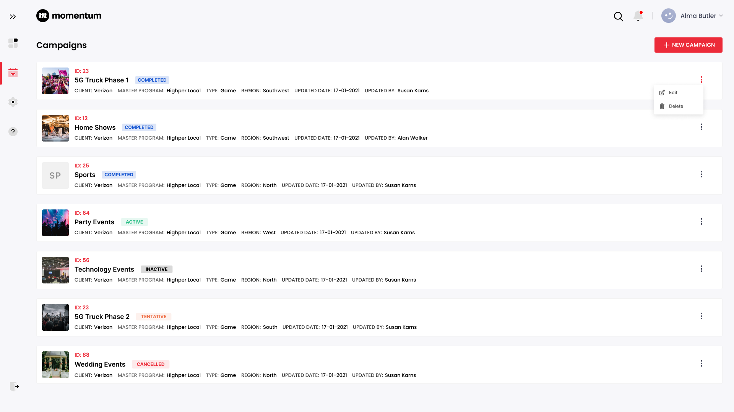
Campaigns

Slide 5
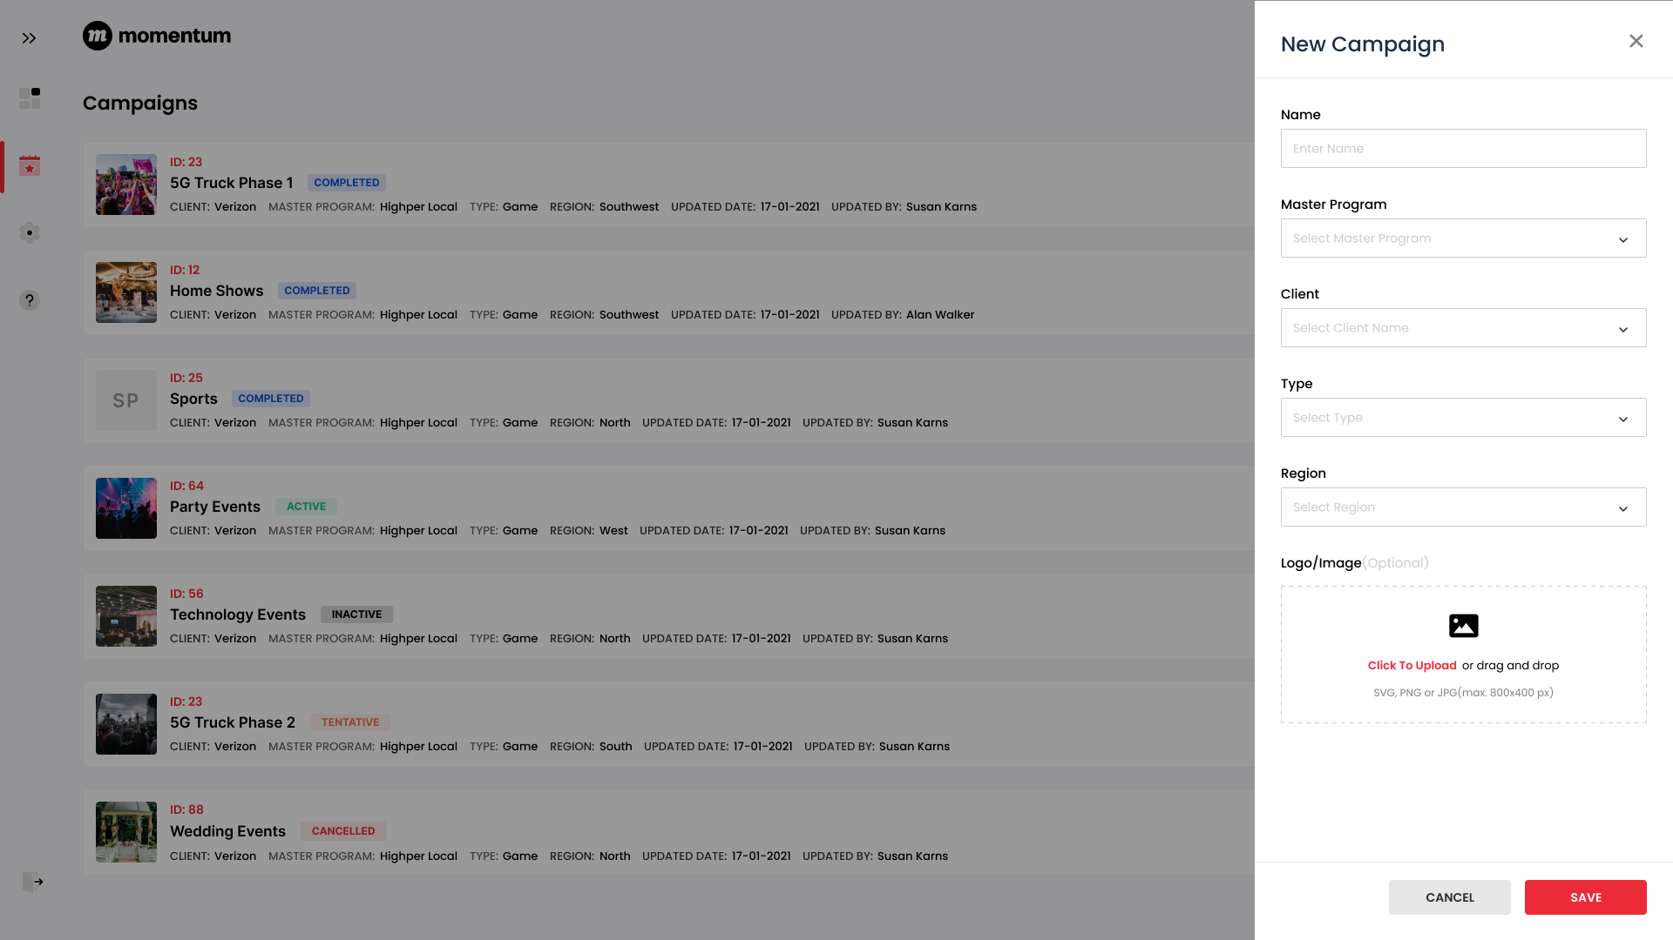
New Campaign

Slide 6
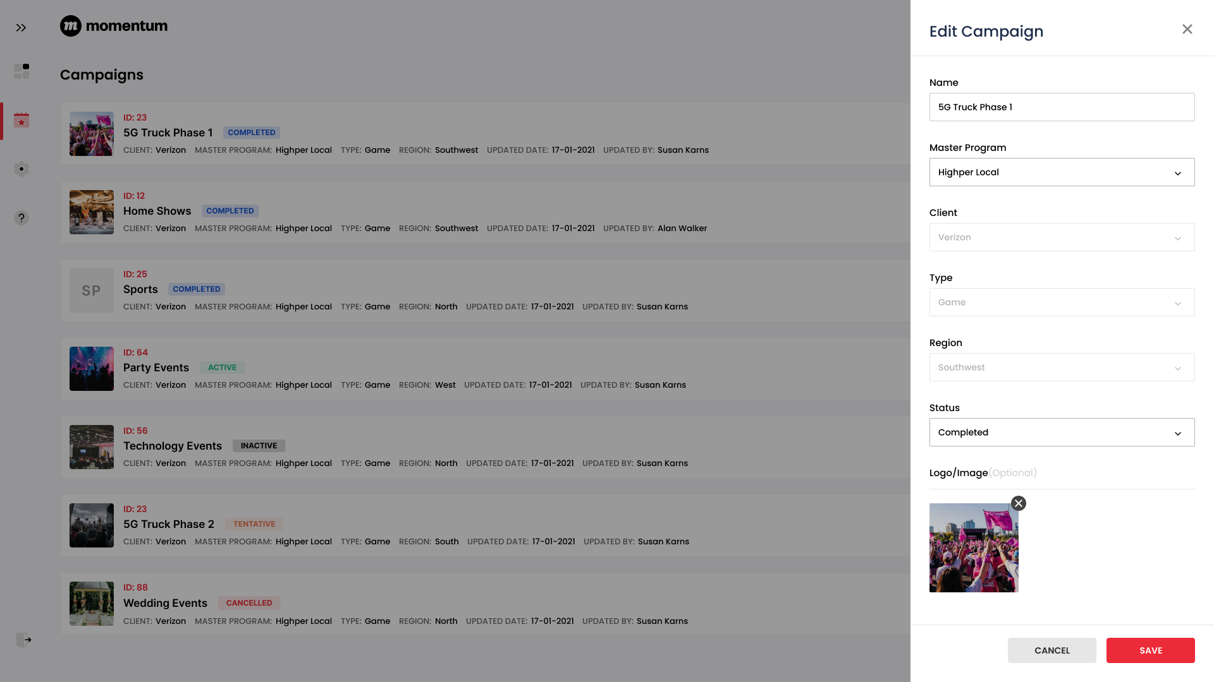
Edit Campaign

Slide 7
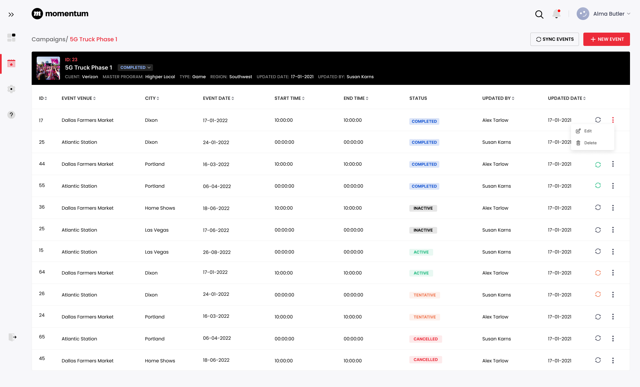
Events

Slide 8
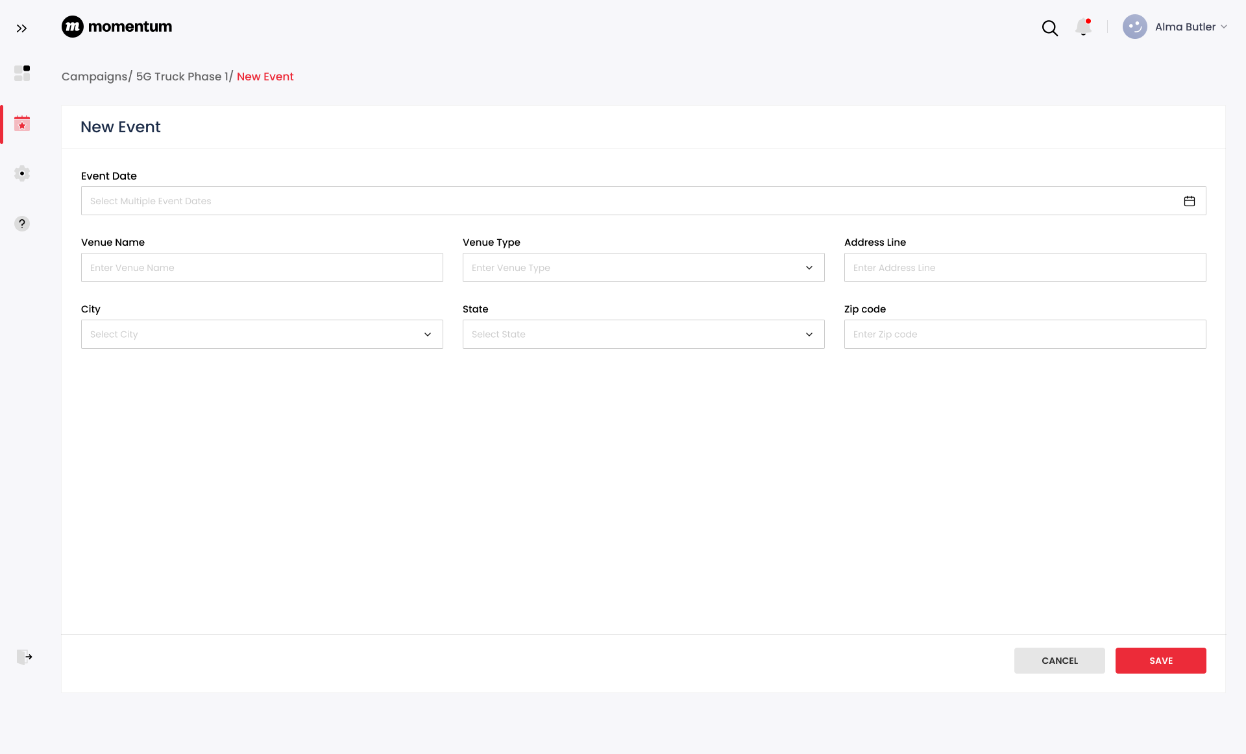
New Event

Slide 9
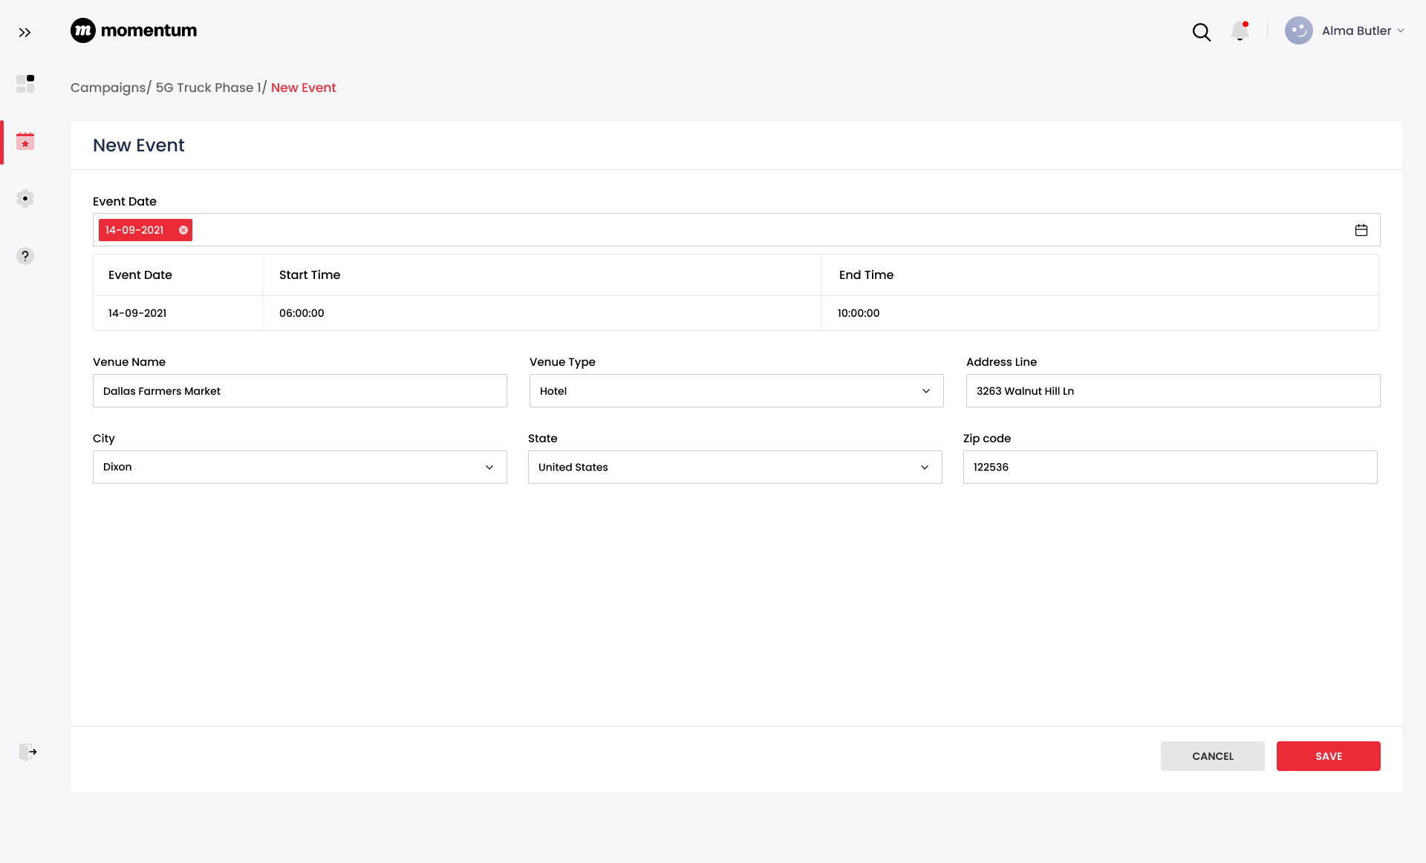
New Event

Slide 10
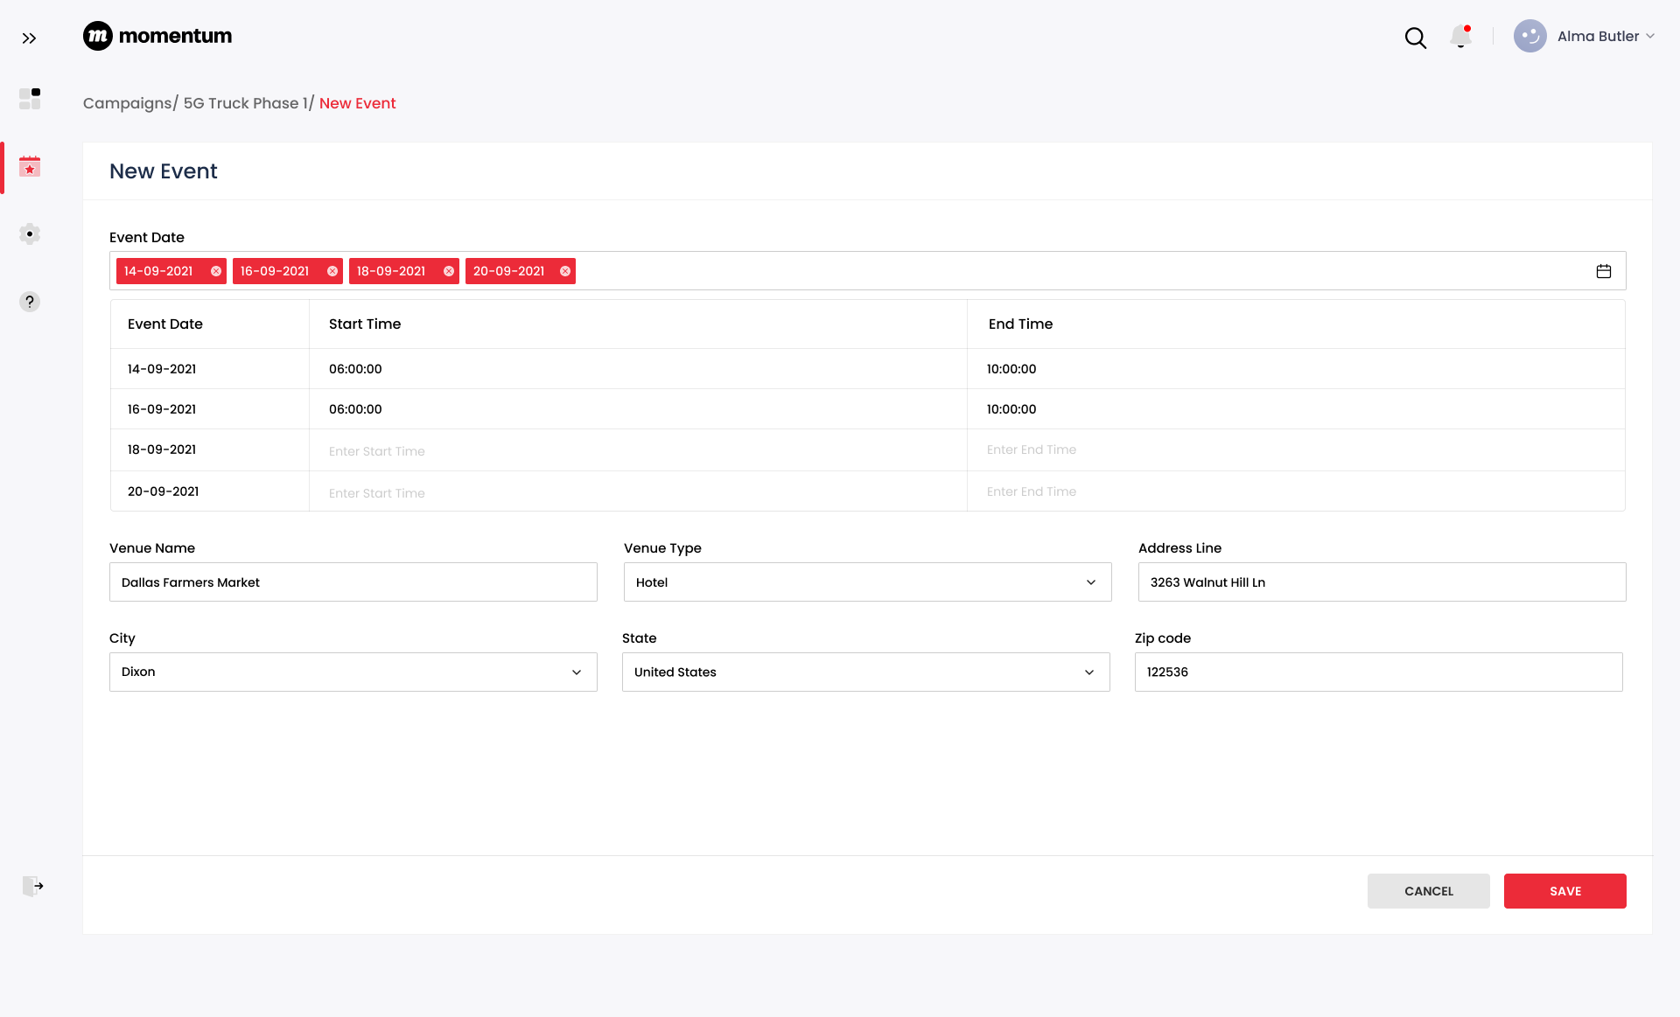
New Event

Slide 11
02
Power App Limitations

Slide 12
Power App Limitations
Licensing is constrained under the Microsoft 365 umbrella
    Power Apps forms can only operate within the licensed business domain. However, users can share content with their colleagues and guest users who have Active Directory accounts and Power Apps licenses. Power Apps Portal also offers third-party and anonymous access.
Power Apps are good for building simple forms quickly, but forms with complex logic can cause problems due to their limited capabilities to manage the code base and track changes.
Version control support for Power Apps is in the Experimental Phase. https://learn.microsoft.com/en-us/power-apps/maker/canvas-apps/git-version-control \
Doesn’t support direct SQL queries. https://powerusers.microsoft.com/t5/Webinars-and-Video-Gallery/Type-and-Run-a-SQL-Query-inside-PowerApps/td-p/113062
Learning curve to write power app functions to filter and perform data operations using power app syntax. https://www.mssqltips.com/sqlservertip/6887/execute-sql-queries-from-microsoft-power-apps/
Power Apps doesn’t provide inbuilt support for pagination ( this is when working with direct SQL queries )
If we use the Canvas application, only one developer can work at a time.
Can not integrate JavaScript in power app forms.
Poor reusability: Power Apps is geared towards those who are not professional programmers. You cannot create functions on Power Apps. Suppose you have a specific block of code that you need to run multiple times. In that case, you will need to copy and paste your code which increases the margin of error, decreases readability, and feels illegal to any programmer.

Slide 13
Power App Limitations
Debugging is very difficult as there is no traditional logging mechanism, but instead a Monitor that shows every command your app runs and whether it was a success or not.
Power BI tile control to integrate Power BI reports in Power Apps:
    When you share an app that contains Power BI content, you must share not only the app itself but also the dashboard where the tile comes from. Otherwise, the Power BI content won't appear even for users who open the app. Apps that contain Power BI content respect the permissions for that content.
    https://learn.microsoft.com/en-us/power-apps/maker/canvas-apps/controls/control-power-bi-tile?source=recommendations#sharing-and-security
For licensing requirements when embedding Power BI tile:
    To view the embedded report, you need either a Power BI Pro or Premium Per User (PPU) license. Or, the content needs to be in a workspace that's in a Power BI Premium capacity (EM or P SKU).
    https://learn.microsoft.com/en-us/power-bi/collaborate-share/service-embed-secure#licensing

